Slide 1
Introduction
Notes:
I don’t own the pictures in the presentation. Ownership goes to the original creators

Slide 2
Agenda
What is Computer, Programming Language and Algorithm
Java Introduction

Slide 3
What is Computer?
According to Internet dictionary, An electronic device for storing and processing data, typically in binary form, according to instructions given to it in a variable program.

Slide 4

Programming Language

Slide 5
What is Programming Language?
A programming language is a formally constructed language designed to communicate instructions to a machine, particularly a computer.
The coded language is used by programmers to write instructions that a computer can understand to do what the programmer.
Eg: C, C++, Java, Python, Haskell…etc.

Slide 6
What is an algorithm?
A process or set of rules to be followed in calculations or other problem-solving operations, especially by a computer.
An algorithm is a self-contained step-by-step set of operations to be performed.

Slide 7
Algorithm vs Program
Step 1: Start
Step 2: Declare variables num1, num2 and sum.
Step 3: Read values num1 and num2.
Step 4: Add num1 and num2 and assign the result to sum.
sum←num1+num2
Step 5: Display sum
Step 6: Stop
public static void main(String args[])
{
int num1,num2,sum;
num1=2;
num2=3;
sum=num1+num2;
System.out.println(sum);
}

Slide 9
Introduction to Java

Slide 10
Java History
James Gosling, Mike Sheridan, and Patrick Naughton initiated the Java language project in June 1991. Java was originally designed for interactive television, but it was too advanced for the digital cable television industry at the time. The language was initially called Oak after an oak tree that stood outside Gosling's office. Later the project went by the name Green and was finally renamed Java, from Java coffee. Gosling designed Java with a C/C++-style syntax that system and application programmers would find familiar.

Slide 11
Introduction to Java
Object oriented language
Portable
Distributed
Secure
Scalable
Robust
Multithreaded

Slide 12
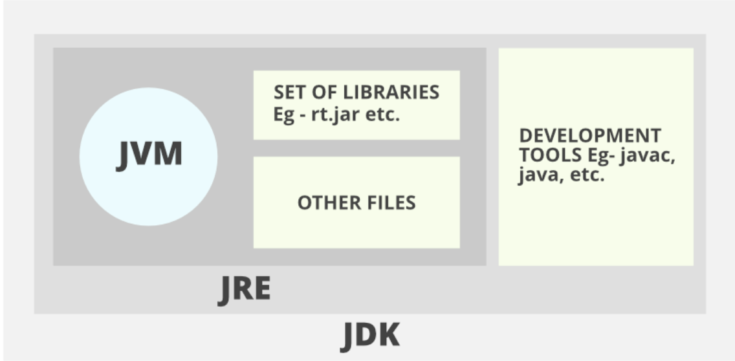
JDK,JRE and JVM
JDK: Java Development Kit
It is a bundle of software that you can use to develop Java based applications.
It includes the JRE, set of API classes, Java compiler and additional files needed to write Java applets and applications.
JRE: Java Runtime Environment
It is basically the Java Virtual Machine where your Java programs run on.
is a plug-in needed for running java programs.
JVM : Java Virtual machine (JVM)
It is the virtual machine that run the Java bytecodes.
Any Java application can be run only inside some concrete implementation of the abstract specification of the Java virtual machine
it provides a machine interface that does not depend on the underlying operating system and machine hardware architecture. This independence from hardware and operating system

Slide 13
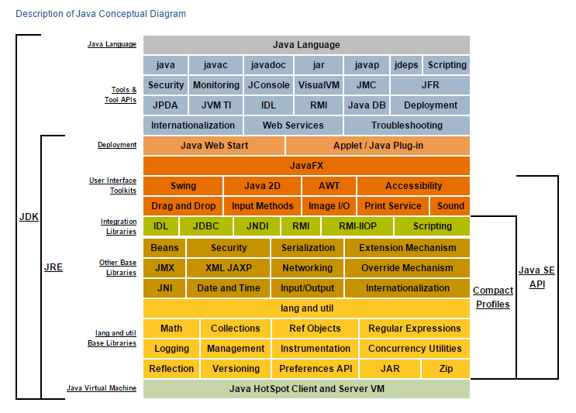
JDK,JRE And JVM

Slide 14
Q and A

